Slide 1
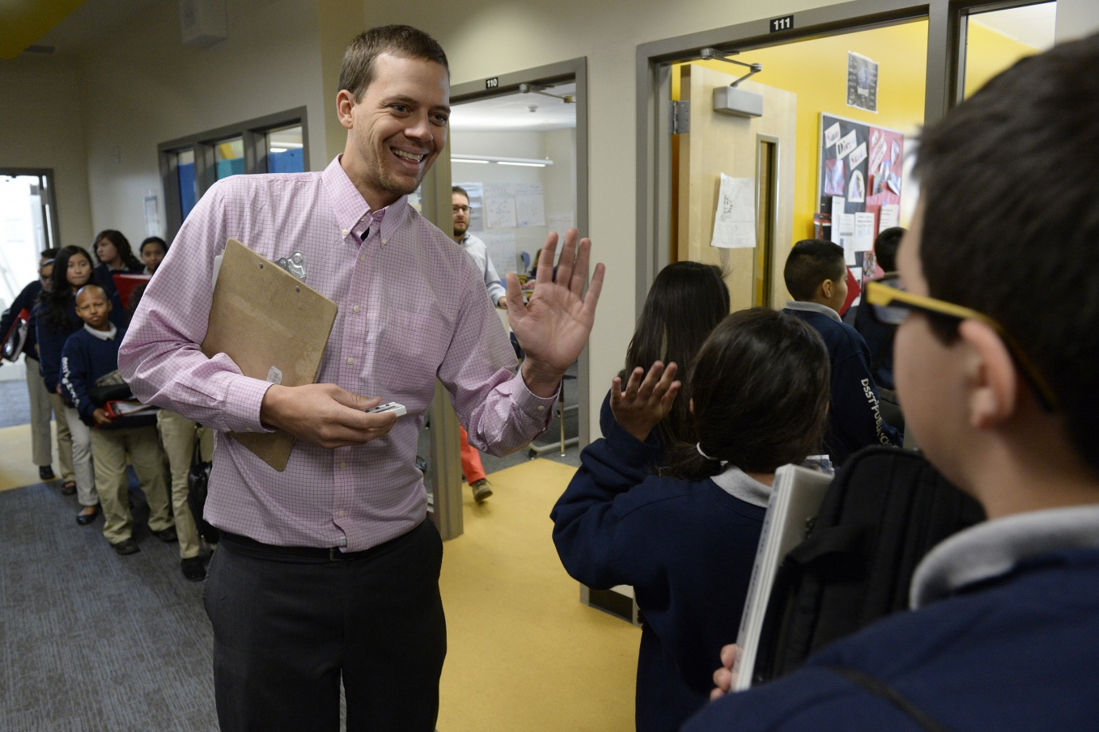
Teachers as Advisors
What is a Teacher as Advisor Program and why do we need to do this?

Slide 2
What is the “teachers AS Advisors” program or taa?
Teachers as Advisors is delivery system whereby large student populations are grouped in smaller pods to receive more personal academic help as well as social, emotional development and an understanding of these skills for college and careers.

Slide 3
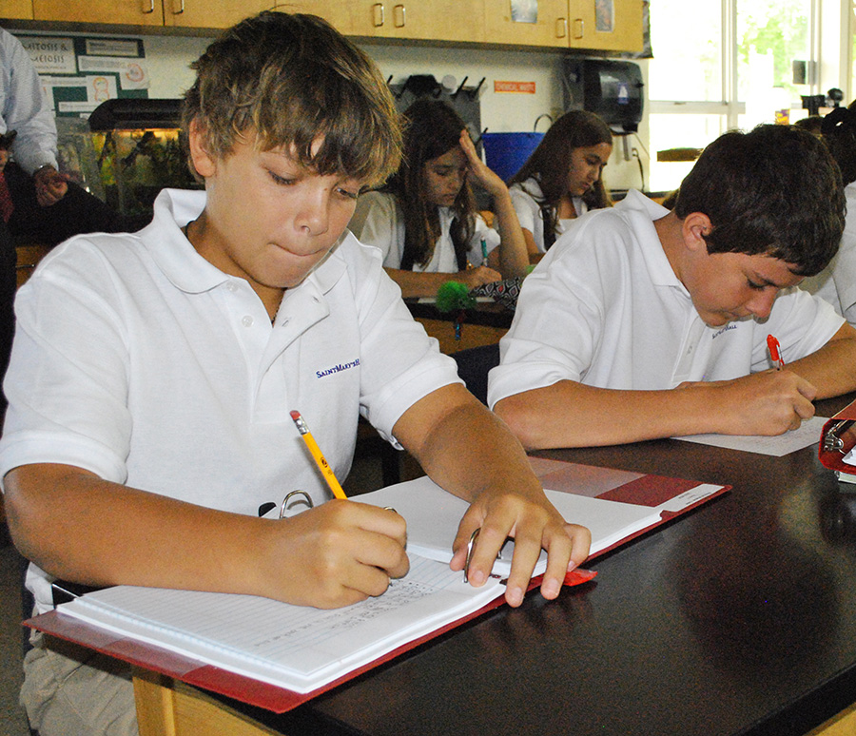
Why Do Schools need to Implement TAA?
To monitor academic progress
To establish a support system for students
To encourage a connection with a caring educator to help students better understand themselves, their strengths and to plan for their future
To assist students with establishing short and long term academic and career goals

Slide 4

Rationale for TAA
Students get more frequent one-on-one advice with Teachers as Advisors (TAA)
Students have a clearer focus on the future and how to plan for high school and college
Students often improve their performance in academics when a caring adult or mentor is focused on their progress

Slide 5
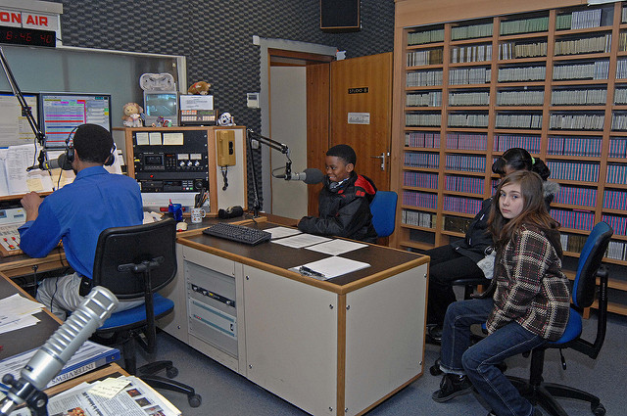
Objectives of TAA
Supporting the mission of Richmond County School System in creating life long learners
To monitor the academic progress of all students periodically
To provide early intervention and accountability for struggling students
To provide opportunities for students to make successful high school and post–secondary career choices
To help students learn about themselves, to explore and investigate the world of work and educational options.

Slide 6
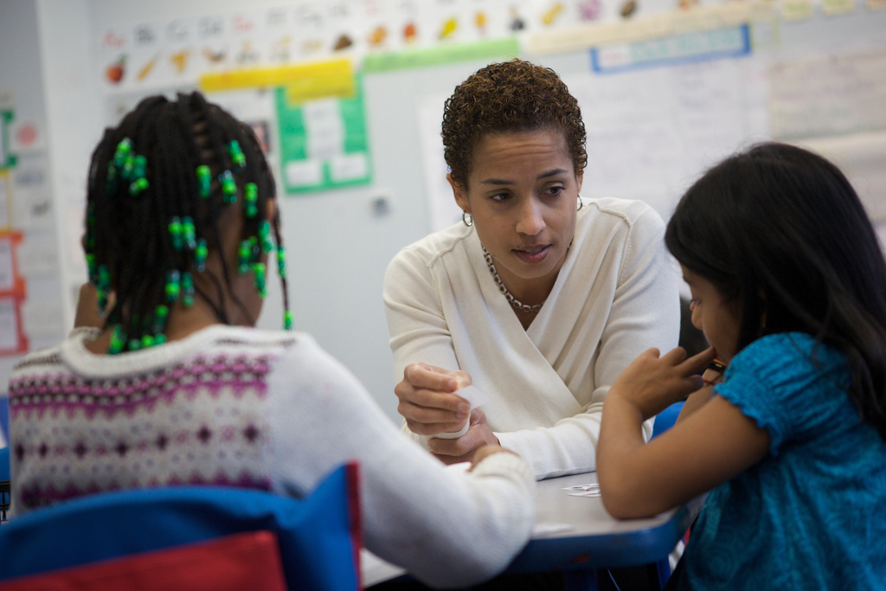
Roles of the Advisor
Provide a nurturing environment which promotes communication between adviser and advisees
Implement advisory program by doing activities and consulting with students on their progress reports and report cards
Serve as an advocate for advisees
Serve as a positive role model for advisees
Monitor academic progress of advisee

Slide 7

Thank you!
With everyone on board, C. T. Walker can have a successful Teachers as Advisors program, supporting our students to discover the best in themselves and setting goals for their future.

